Slide 1
Towards Unit of Work
CIDM 6330
APP – Chapters 5 and 6
Spring 2021

Slide 2
Continuing with TDD
APP Chapter 5

Slide 3
Ranging Up and Down the Testing Pyramid
With a layered architecture
The level at which a test should be inserted is worth consideration
Levels:
Unit
Integration
End to End
Test Domain Directly?
If the only way to access the Domain is through a service…
Testing the point of request and delivery…

Slide 4
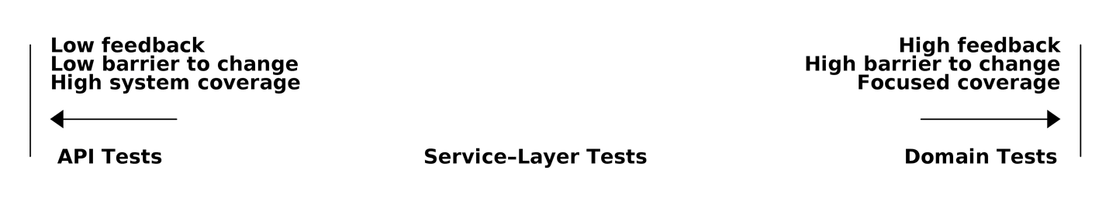
It Depends (it always does)
Decouple These
“Normal Science” or “Paradigm Shift?”

Slide 5
Unit Of Work Pattern
APP Chapter 6

Slide 6
Stitching It Together
Unit of Work Pattern
Broker between Repository and Service Layers
Abstraction for
Atomic operations to and from the repository and services
Simplifies use
Perhaps not design

Slide 7
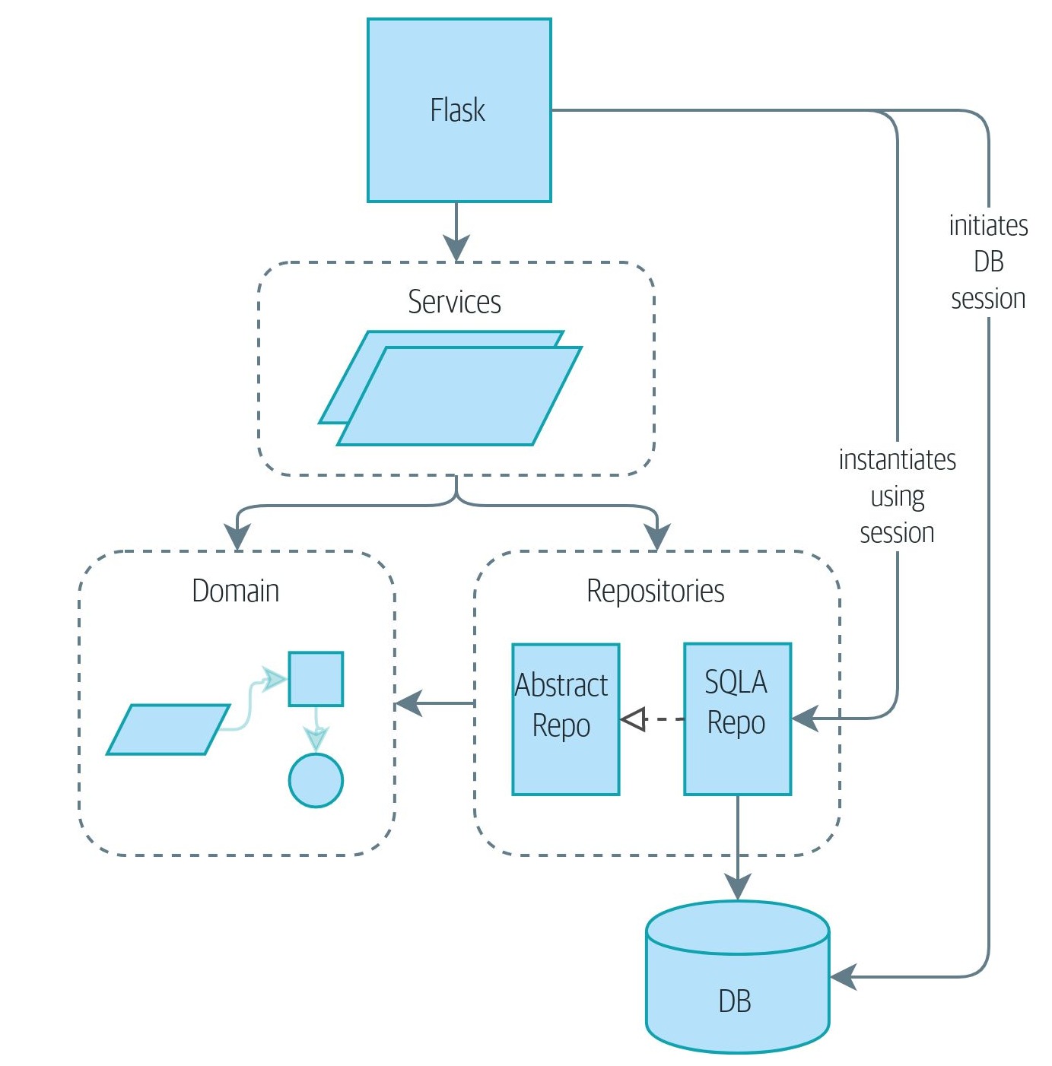
Without UoW

Slide 8
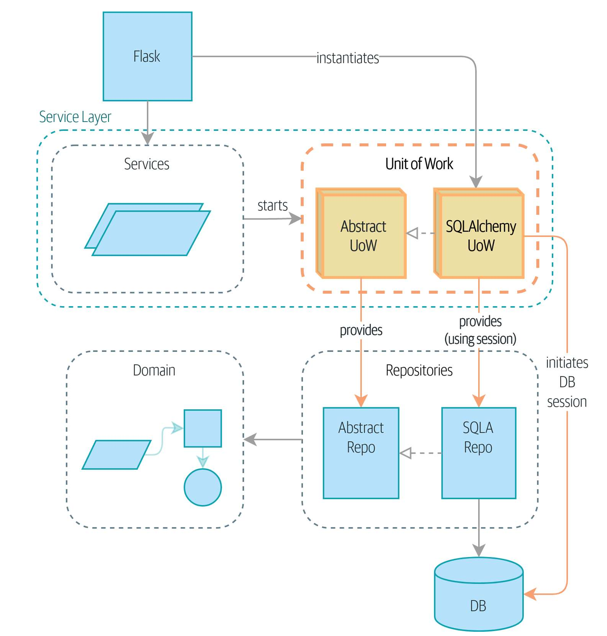
With UoW

Slide 9
Pros and Cons of Unit of Work
Pros
Cons
Abstract the atomic operations for state and persistence
Context Managers encourage transparency
Explicit transactional control
Central hub for repositories
Grand Central Station for Transactions, Events, and Messages
Often solved/addressed by an O/RM tool
Wheel reinvention and complexity expansion
You have to handle everything yourself (DIY)
Django or Flask-SQLAlchemy – to be Python-specific – automagically handles these things.

Slide 10
Recap
The Unit of Work pattern is an abstraction around data integrity
It helps to enforce the consistency of our domain model, and improves performance, by letting us perform a single flush operation at the end of an operation.
It works closely with the Repository and Service Layer patterns
The Unit of Work pattern completes our abstractions over data access by representing atomic updates. Each of our service-layer use cases runs in a single unit of work that succeeds or fails as a block.

Slide 11
Recap More
Makes the case for Context Managers
Context managers are an idiomatic way of defining scope in Python.
Use a context manager to automatically roll back work at the end of a request, which means the system is safe by default.
SQLAlchemy already implements this pattern
UoW introduces an even simpler abstraction over the SQLAlchemy Session object in order to “narrow” the interface between the O/RM and code.
This helps to keep code loosely coupled.

